Slide 1
AUTOMATIC IRRIGATION SYSTEM
Shruti Kakhe (1946491245049)
Tejaswini Dhage (1946491245068)
Shreya Agnihotri (1946491245042)
Nikhil Dhage (1946491245043)
Prof. Ajay Sahu

Slide 2
Problem Statement
Everyone is aware of how crucial irrigation is to all forms of agriculture is used for plant growth.
The issue is that irrigation requires sprinklers that are connected to extremely powerful batteries, which calls for three phase of power supply and majority of villages in India does not have three-phase electricity at the day time, it’s only available at night.
As a result, the farmers must travel at night to start the motor and return later to turn it off. It could result in a number of troublesome circumstances, including animal or thief attacks and many other problems.
In addition, manual irrigation may result in crop damage due to inadequate or excessive water supply to the crops.

Slide 3




Objectives
To supply water to the crops according to their needs.
To avoid all the time-consuming process by assigning the tasks automatically.
To keep the track of tasks.
To reduce extra effort.

Slide 4
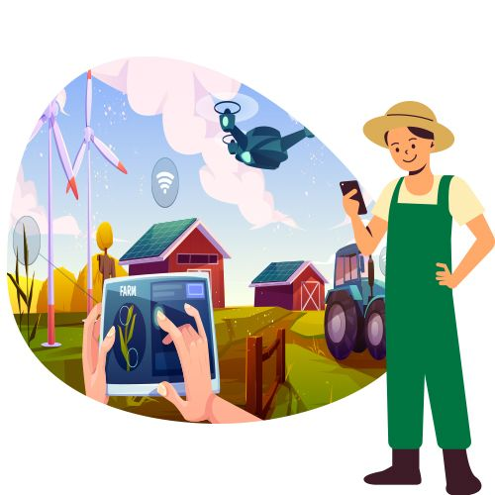

Stakeholders
Farmers
Admin

Slide 5
Literature Survey
Sr. No | Details of Paper | Work Reported
1. | H. M. Yasin, S. R. M. Zeebaree and I. M. I. Zebari, "Arduino Based Automatic Irrigation System: Monitoring and SMS Controlling," 2019 4th Scientific International Conference Najaf (SICN), 2019, pp. 109-114, doi: 10.1109/SICN47020.2019.9019370. | The paper purposes, a new system is designed to monitor and operate the irrigation system. The system uses the Arduino mega 2560 enhanced with Global System for Mobile communication (GSM) technology so that Arduino platform allows to receive/send SMS to/from the mobile of farms/homeowner according to soil needed for water or the instructions sent by the user. The system is equipped with moisture sensors that are inserted in the soil to irrigate the plants automatically if the ground is dry or controlled by mobile using SMS messaging.
2. | P. B. Wakhare, S. Neduncheliyan and G. S. Sonawane, "Automatic Irrigation System Based on Internet of Things for Crop Yield Prediction," 2020 International Conference on Emerging Smart Computing and Informatics (ESCI), 2020, pp. 129-132, doi: 10.1109/ESCI48226.2020.9167626. | The paper purposes design and implementation of smart automation system for farms alongside constantly analysing and reporting real time data from the field. In this paper explain about the prototype design of microcontroller based intelligent irrigation system controller which will allow irrigation to take place from remote places where manual inspection is not needed. According to pH value of soil, a list of best suited crop is selected from all crops. Values of monitoring parameters are adjusted according to optimal condition required for particular crop.
3. | Lita, D. A. Visan, A. Gheorghita Mazare, L. M. Ionescu and A. I. Lita, "Automation Module for Precision Irrigation Systems," 2020 IEEE 26th International Symposium for Design and Technology in Electronic Packaging (SIITME), 2020, pp. 136-139, doi: 10.1109/SIITME50350.2020.9292300. | The paper purposes the improved design for an automation module which is dedicated for applications in irrigation systems used in precision agriculture. The architecture of the automation module relies on Arduino Uno development board containing the microcontroller ATmega328P which performs the majority of the control tasks required in the operation of the proposed system.

Slide 6
Literature Survey
Sr. No | Details of Paper | Work Reported
4. | S. Peraka, R. Sudheer, B. N. Rao, A. R. Teja and E. N. Kumar, "Smart Irrigation based on Crops using IoT," 2020 IEEE 15th International Conference on Industrial and Information Systems (ICIIS), 2020, pp. 611-616, doi: 10.1109/ICIIS51140.2020.9342736. | The paper purposes a new irrigation system, which works based on the latest IoT technology to reduce the wastage of water and it reduces manual labor to irrigate the crops. The main objective of the proposed irrigation system is to supply the required amount of water to the crop based on the type and stage of the crop. The proposed irrigation system pumps the water to the crop based on the type, area, and date of the plantation of the crop, and these parameters are registered by the farmer through the IoT-based Android App.
5. | Dr. S. Velmurugan, V. Balaji, T. Manoj Bharathi, K. Saravanan, 2020, An IOT based Smart Irrigation System using Soil Moisture and Weather Prediction, INTERNATIONAL JOURNAL OF ENGINEERING RESEARCH & TECHNOLOGY (IJERT) ECLECTIC – 2020. | This paper is based on the application specific sensors' data acquisition and intelligent processing, are bridging the gaps between the cyber and physical worlds. IoT based smart irrigation systems can help in achieving optimum water-resource utilization in the precision farming landscape. This paper presents an open-source technology based smart system to predict the irrigation requirements of a field using the sensing of ground parameters like soil moisture, soil temperature, and environmental conditions along with the weather forecast data from the Internet.

Slide 7
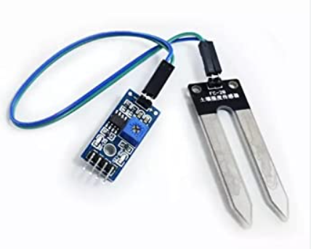
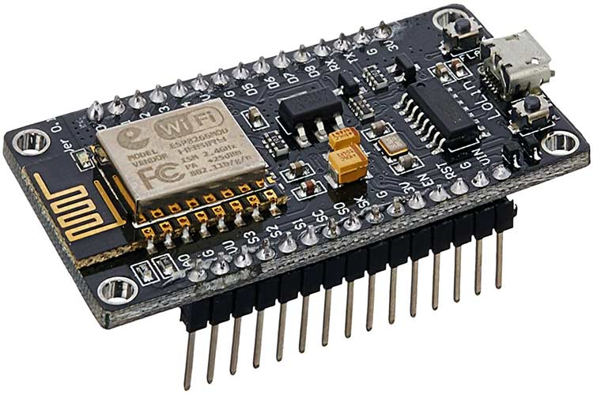
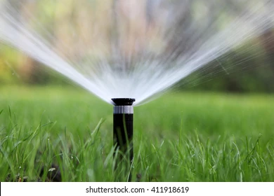
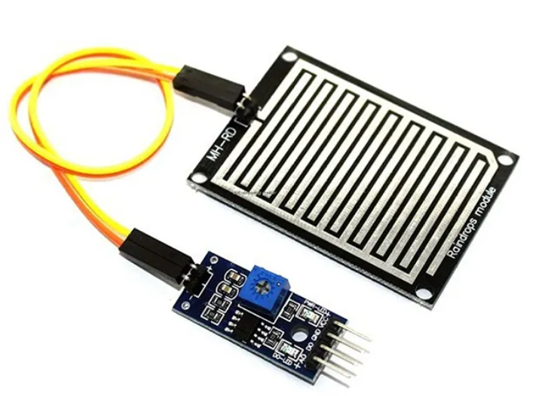
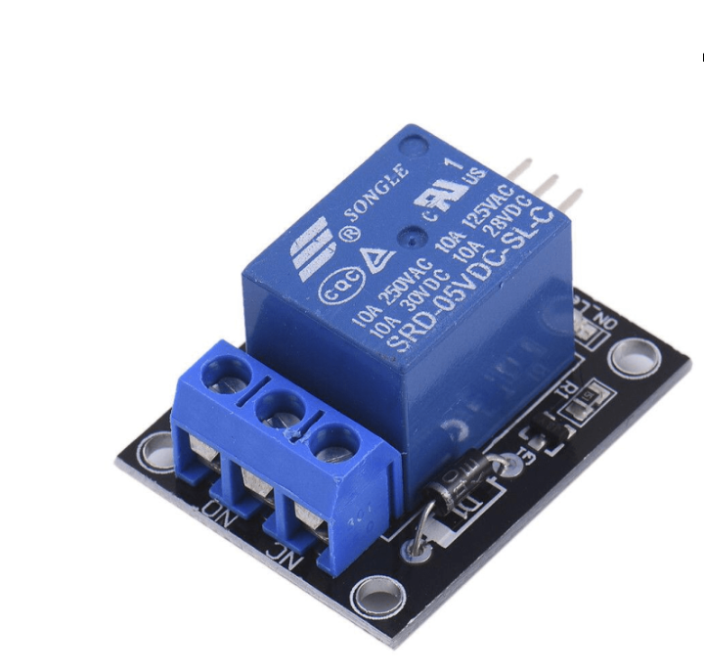
Tools

Slide 8


Technology Used

Slide 9
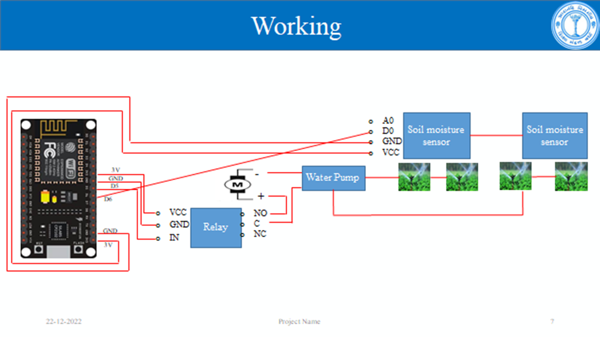
Proposed Solution

Slide 10
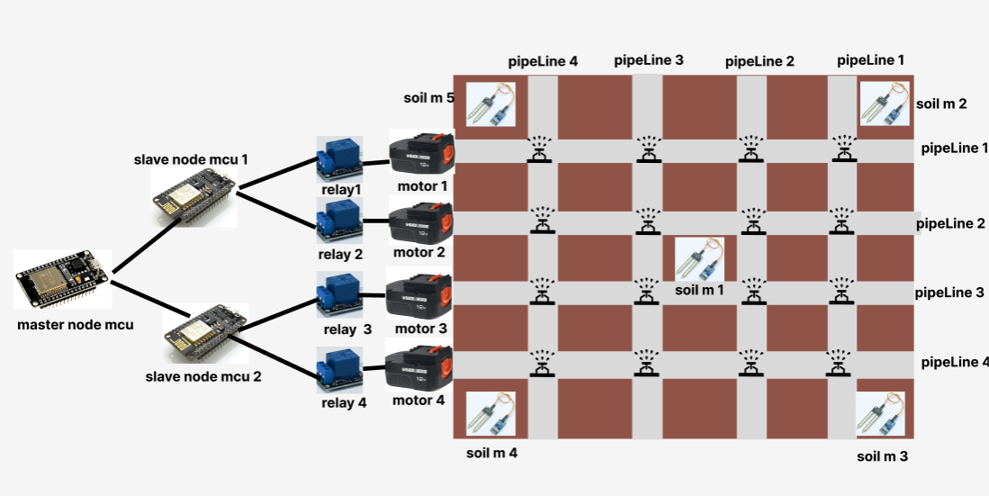
Proposed Solution

Slide 11
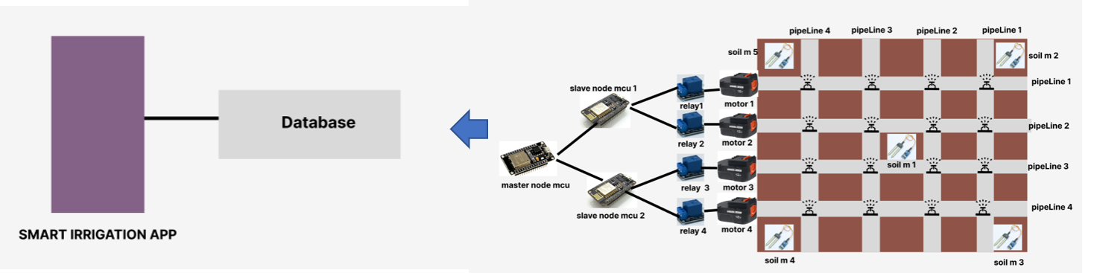
Expected Outcome

Slide 12
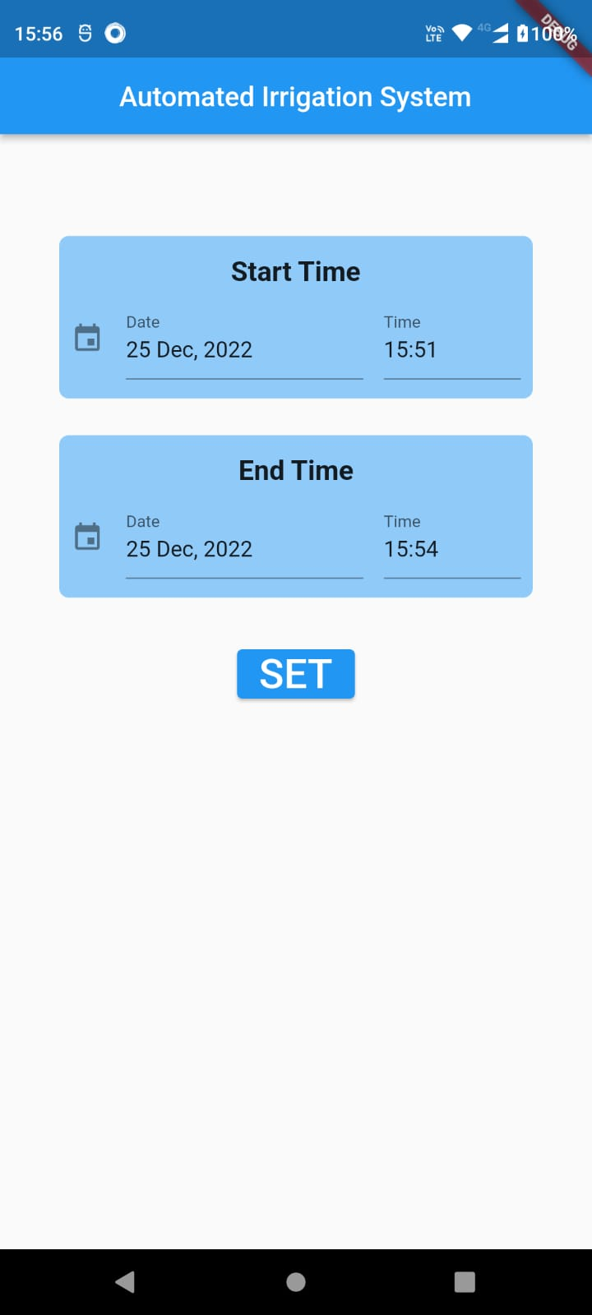
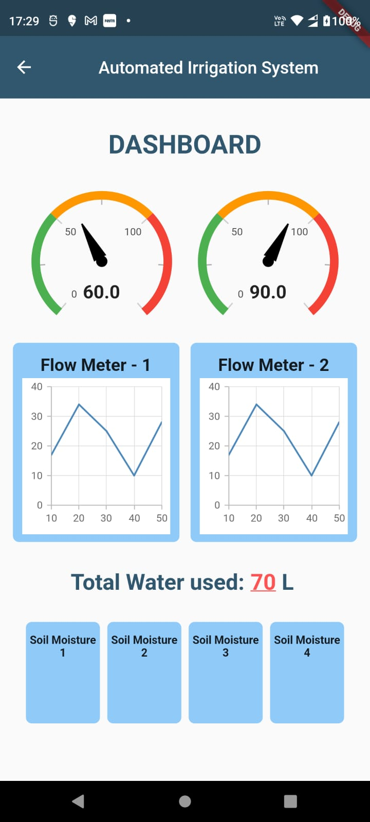
Screenshots

Slide 13
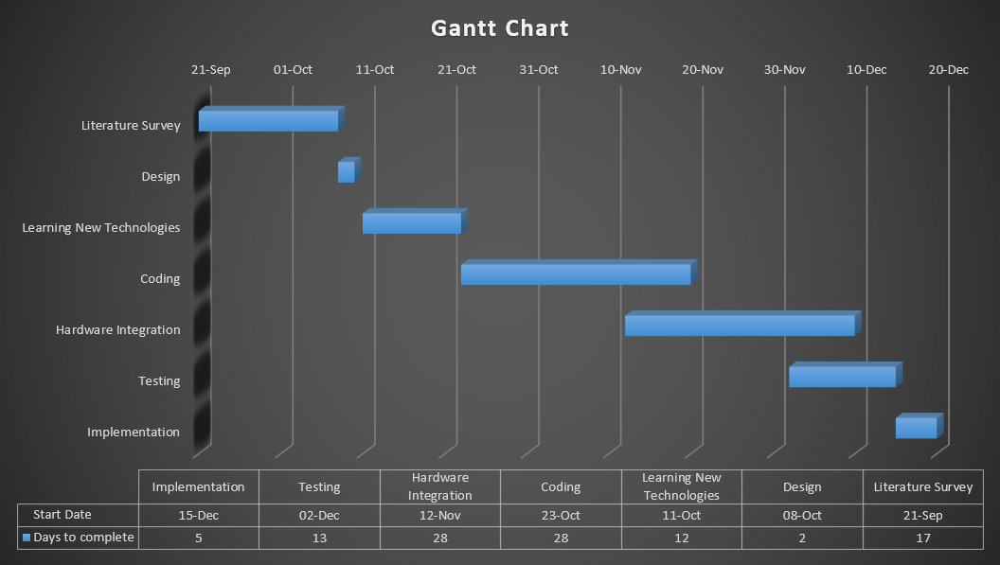
Project Timelines

Slide 14
Conclusion
Thus, an efficient system is proposed, designed and implemented that remotely controls and monitors the irrigation process.
By using modern technology, irrigation has become easier through the use of soil moisture sensors and the measurement of their value through the microcontroller and automatic ordering of irrigation without the need to use workers to do so and helping farmers especially reduced the work and risk which farmers used to take at the night time for irrigation and saving their time and effort has become one of the things to be considered . The use of automatic irrigation leads to improving the growth of the plant and reducing the wilting of leaves, by giving water to meet the requirements of growth.

Slide 15
Thank You.

